Slide 1
POPS! Proactive Outreach Program for Society

Slide 2
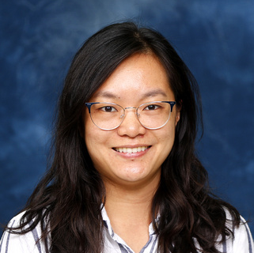

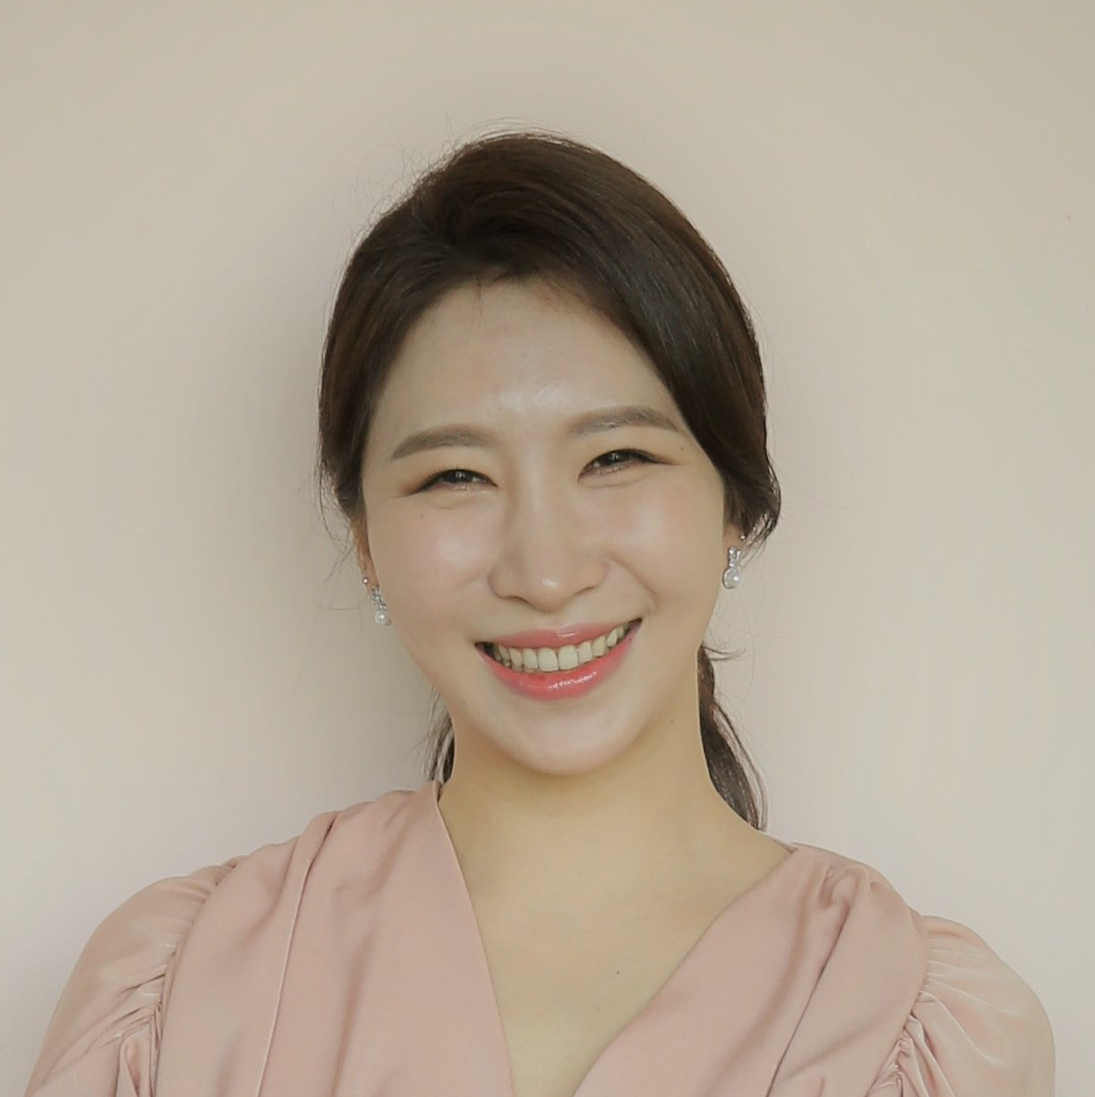
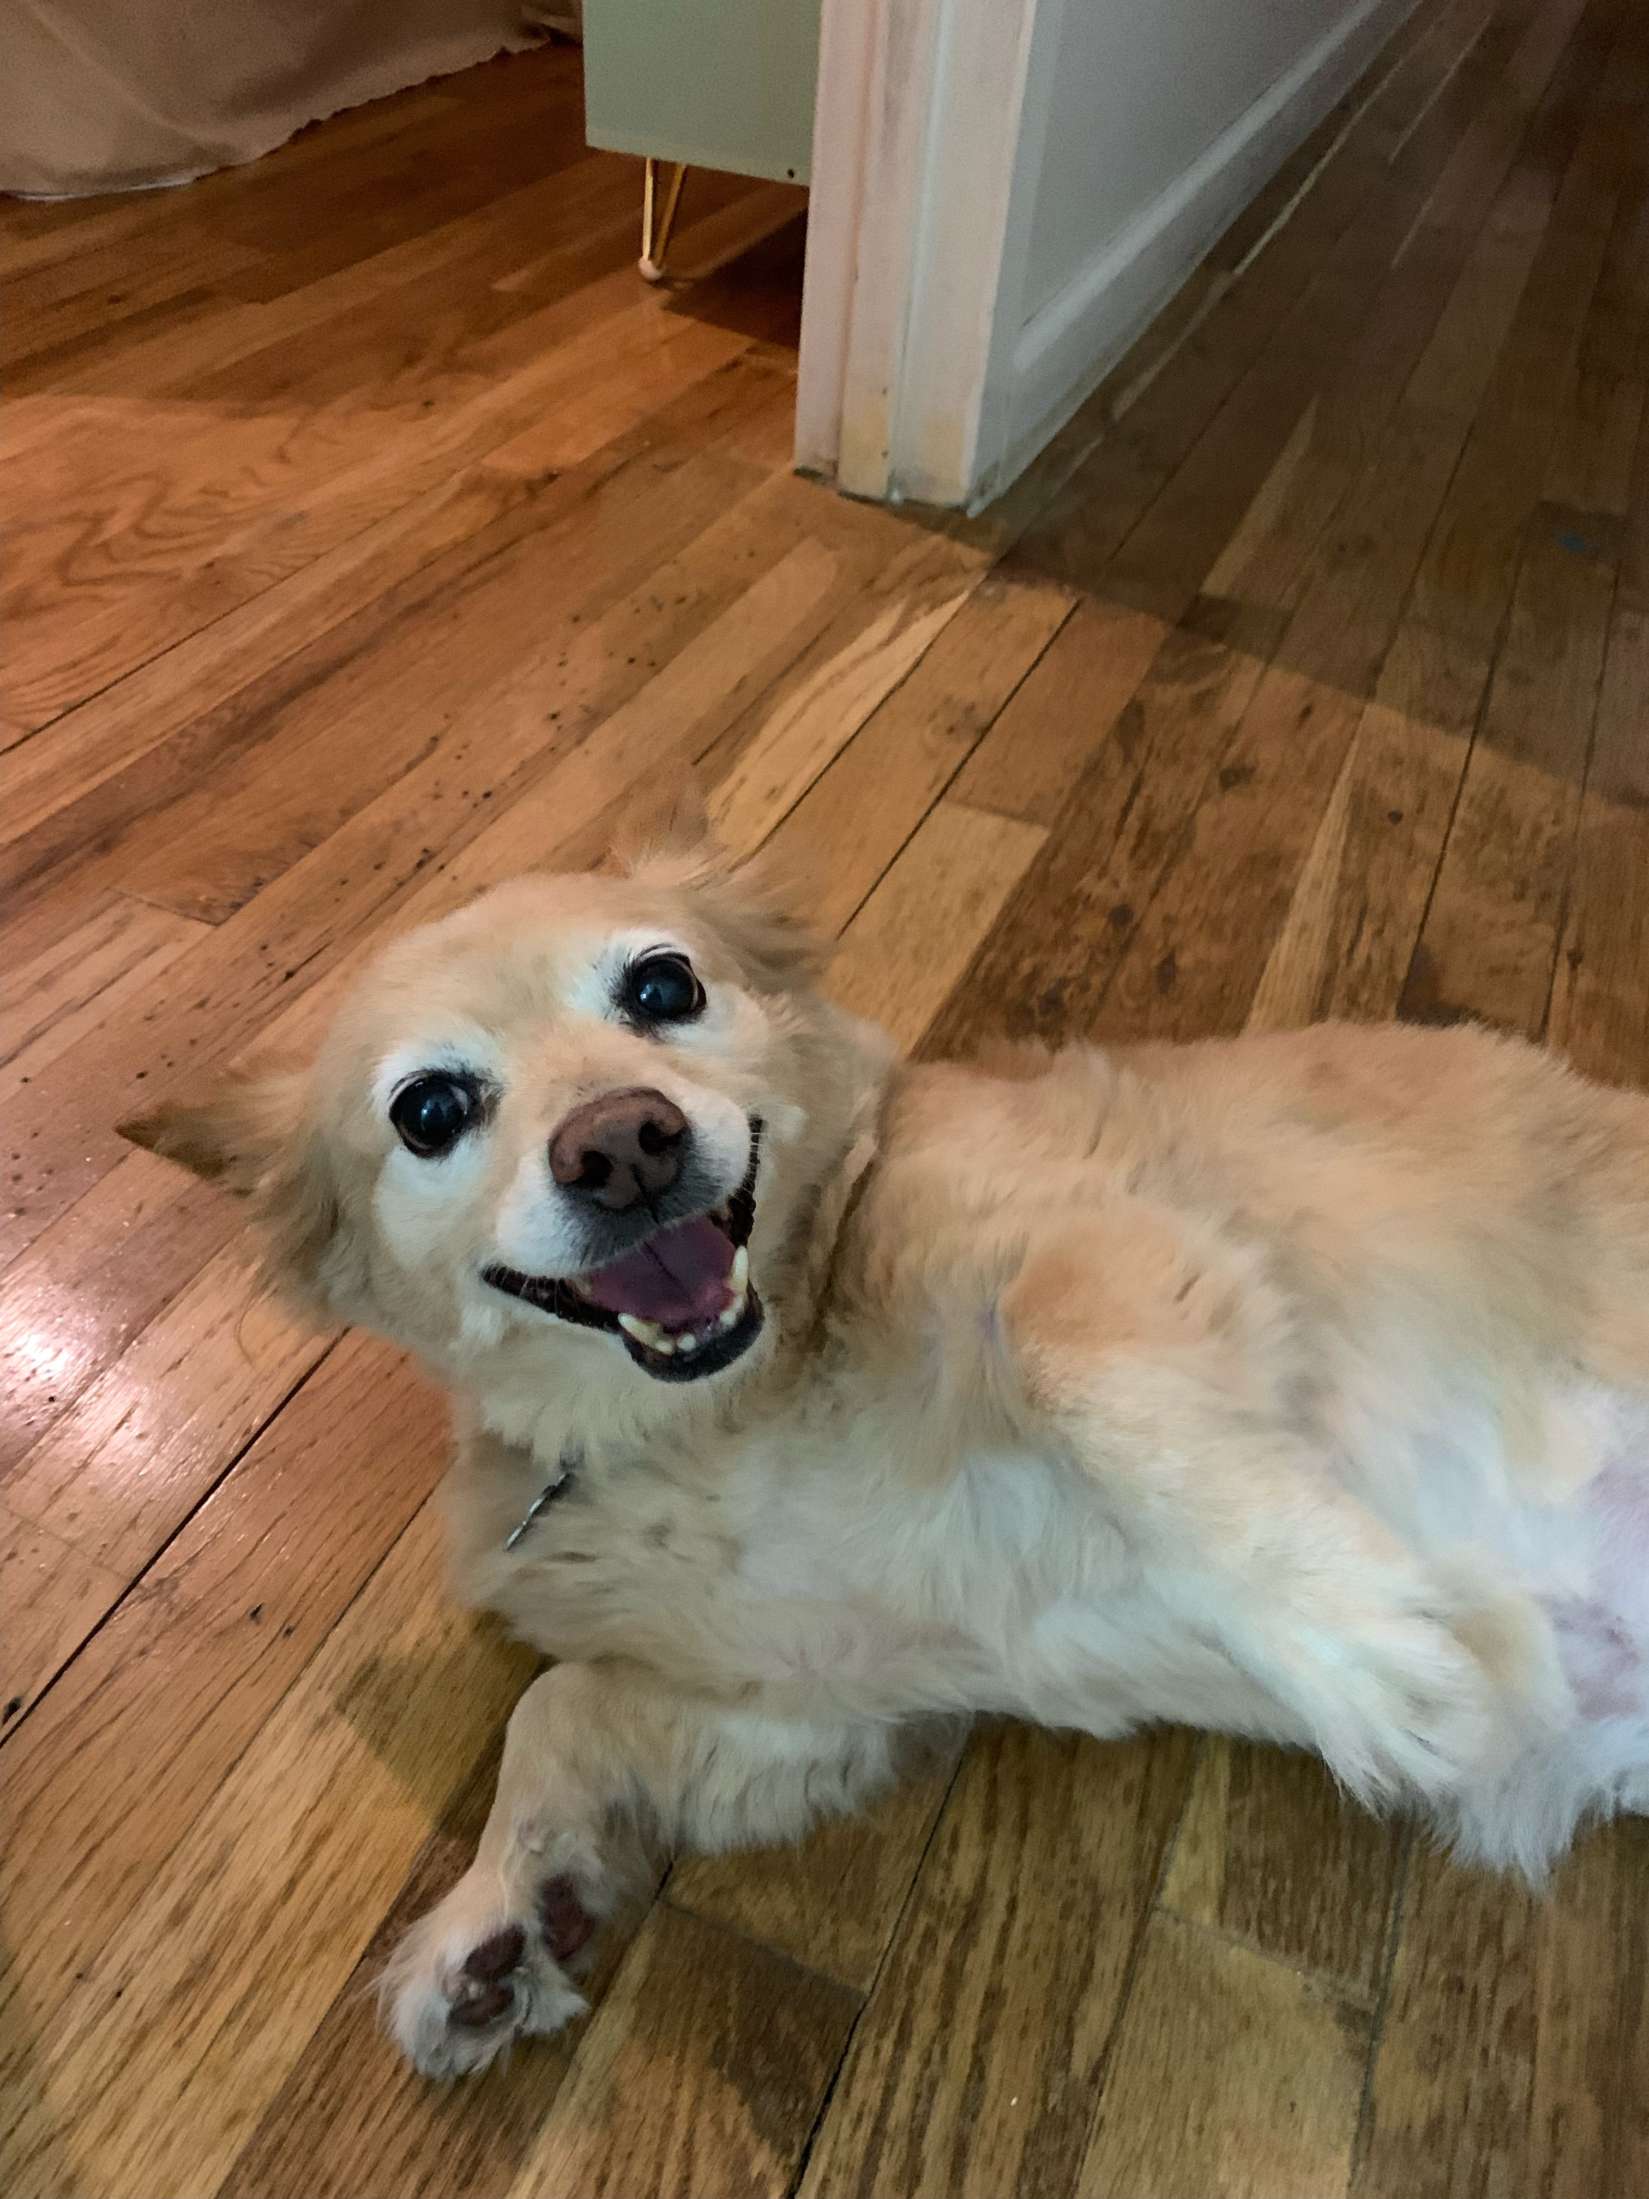
KAREN CHIEN
XINHONG LI
WONKI LEE
MOMO CHIEN
Data Scientist
Data Scientist
Data Scientist
Barketing Manager

Slide 3
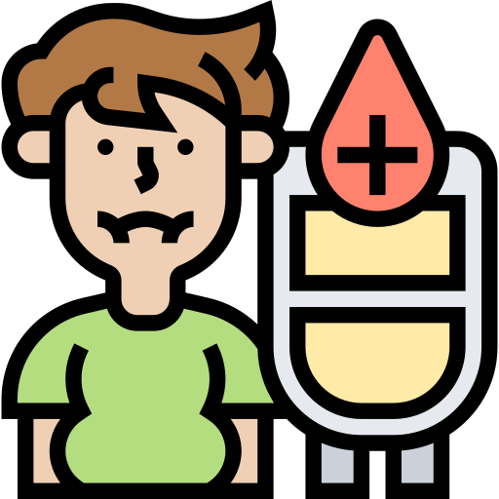

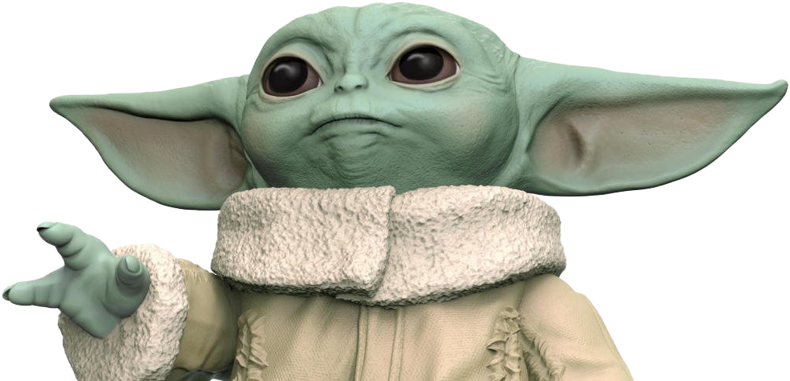

SOCIAL DETERMINANTS
TYPE 2 DIABETES
SUPPORT
SYSTEM
YODA: Chatbot based on Community Needs
DrugInfo: Drug Recommendation System

Slide 4
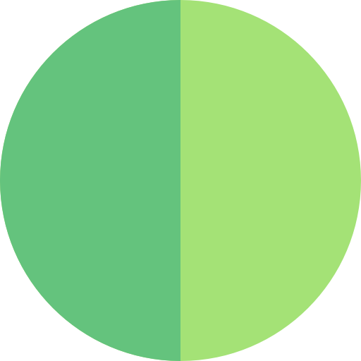
Social Determinants
Relationship between Social Vulnerability and Type 2 Diabetes with modeling
County-Level Findings
Community based socio-demographic/economic characteristics
Initiate Chatbot
Using Chatterbot, drafted Chatbot
CHATBOT
Type 2 Diabetes
Webscrape Reddit data from /r/diabetes
NLP & Text Analysis
Find the most frequent words and bi/trigrams to understand the needs
Educate Chatbot &
Drug Recommendation System
Provided county/community level diabetes information chatbot need to learn
YODA: Your Own Diabetes Assistant
Diabetes Drug Data
NLP on drug review with Sentiment analysis
Predict Drug Satisfaction
Modeling to predict drug satisfaction of diabetes patients
Diabetes Drug
Recommendation System
Based on patient profile, individual-based drug recommendation system was initiated.
DRUG
INFO: Drug Recommendation System
EDA
MODELING
SYSTEM DEV
DELIVERABLES

Slide 5

YODA: Your Own Diabetes Assistant
COUNTY LEVEL DIABETES INFO
Based on Social Vulnerability
“Any diabetes center in Jones, NC?”
There is Free/Low-Cost Class: 418 NC Hwy. 58 N. Unit C / Trenton, North Carolina 28585 | http://www.jonescountyhealth.com | (252) 448-9111
GENERAL DIABETES CONCERNS
Based on Reddit text data
“What is prediabetes?”
Prediabetes means a person’s blood glucose (sugar) level is higher than normal. People with prediabetes can get type 2 diabetes.
DIABETES DRUG INFO
Based on patients’ drug review
“What is Metformin?”
Metformin is one of the best drugs to treat diabetes, it is very affordable, it used with a proper diet and exercise program and possibly with other medications to control high blood sugar.
BASIC GREETINGS
Based on corpus
“May the force be with you”
May the force be with you

Slide 6


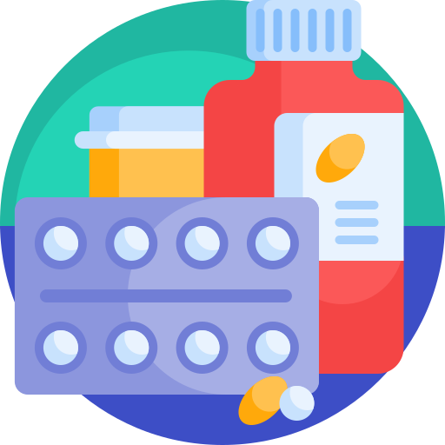

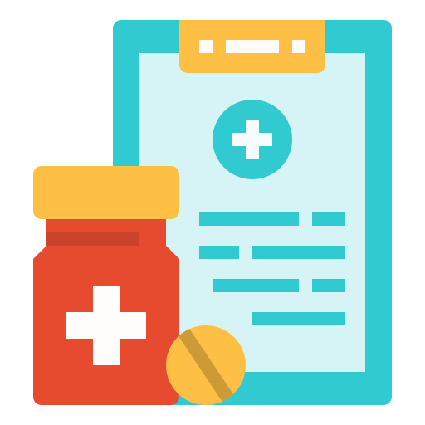

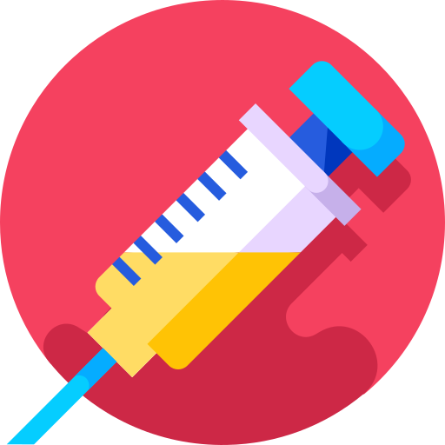

DrugInfo: Diabetes Drug Recommendation System
SEARCH DRUG INFO
CHECK REVIEWS
DRUG RECOMMENDATION

Slide 7
Meet YODA, Your Own Diabetes Assistant

Slide 8
CONSIDERING ALTERNATIVE DRUGS?
SEARCH YOUR DRUG INFO HERE
CHECK OTHER PATIENT’S REVIEW

